Slide 1


Enterprise Architect - Detailed Design Generator
More Lives Saved
More Life Lived
David Puscasu
RBE

Slide 2
Brief Introduction
Enterprise Architect - Detailed Design Generator Tool is an internal tool created by the RBE team that aims to generate the detailed design file obtained based on certain inputs.
At the base of this tool are several tools run from the main Python script, each tool having a well-defined role.
The result obtained will be a new Model Package in the Enterprise Architect architecture project.

Slide 3
The running mode of entire tool
One of the modes of operation of this tool is the mode of operation based on c_template files which involves the creation of c_template files which will be the basis for creating source code files.
These c_template files will contain a code like pseudocode, their purpose being functions in the respective software component.
In order to exemplify this mode of operation, an example module has been created that contains the c_template files associated with this module.
These c_template files will also be in the folder where the project source code files will be located (s:\Scripts\Configuration_Management\EA_Detailed_Design_Generator\Examples\Example_Module\).

Slide 4
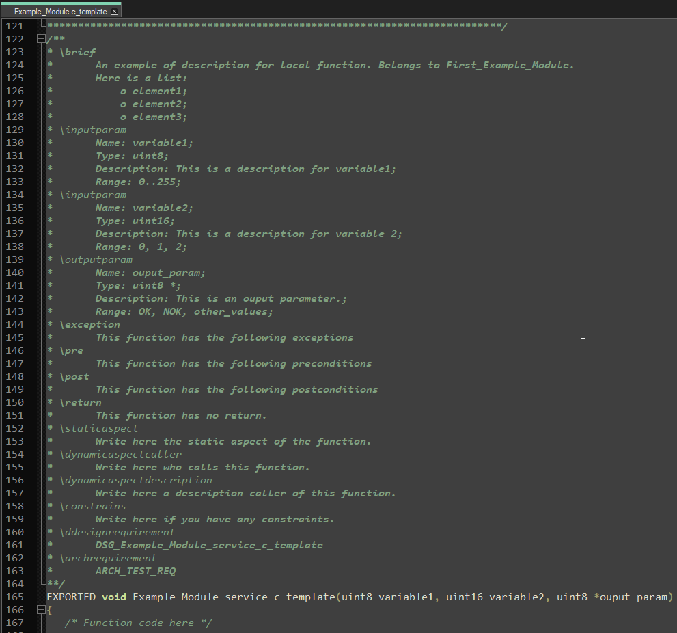
The running mode of entire tool
As can been seen, these files will have the extension c_template, and after writing them and generating the design document, they can be easily modified into c source files code.
Both comments (written according to Comments Rules for Enterprise Architect – Detailed Design Generator document) and certain portions of code will be parsed from the c_template file.
The second mode of operation of the tool involves the direct parsing of the source code files c.

Slide 5
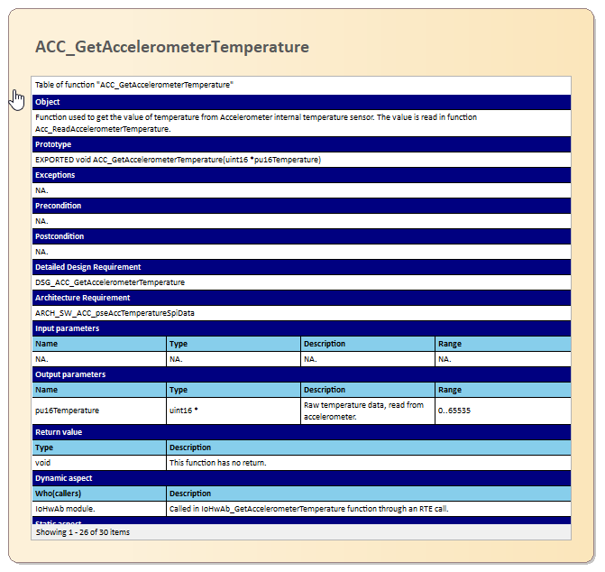
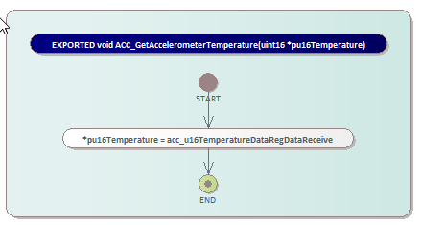
Tools used by Detailed Design Generator
Several auxiliary tools were used to generate the final report, namely:
Doxygen - is a tool used in parsing comments added according to a certain format over each type of data in the source code. The Doxygen with a project was configured in the Tools folder of the script, no need to reconfigure it from 0.
yFlowGen - is necessary to make the connections between the code and the graphic made. No need to configure this plugin.
Enterprise Architect - is the tool in which all Detailed Design documentation will be generated. Here will be added tables with data parsed by the Doxygen tool and charts parsed from svg files generated by the yFlowGen tool.

Slide 6
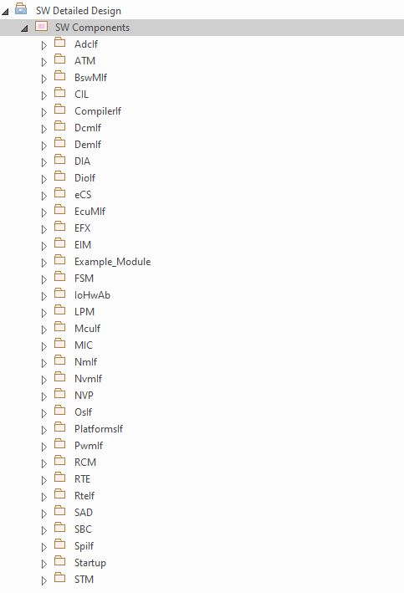
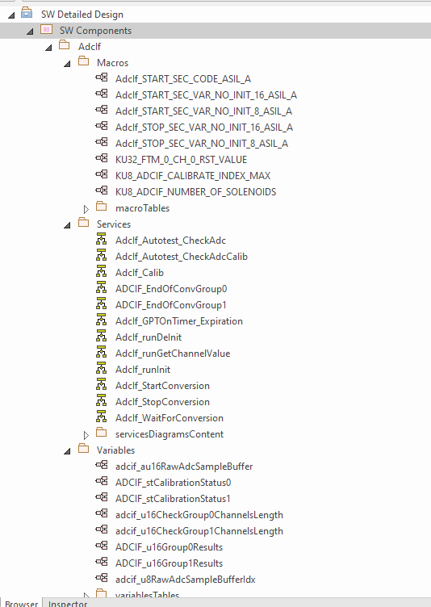
What the generated Enterprise Architect project will look like

Slide 7
Parsed Data Types
Detailed design tool can parse the follow types of data in the generated document:
macros - for each defined macro that will have a comment like the one in the template components, a table will be generated with the description of the respective macro.
variables - for each variable that will have a comment defined as the one in the template components, a table will be generated with the description of the variable as well as its type.
services - this tool will analyze each function in a table containing essential information to the purpose of that function, as well as the graph generated by the yFlowGen tool reinterpreted with elements from Enterprise Architect. Not all functions may have charts, so if charts cannot be generated for a particular function, the tool will notify the user in the console of those functions for which charts have not been generated. If for a function the tool could not create graphs, only the table associated with the function will be added in Enterprise Architect.

Slide 8
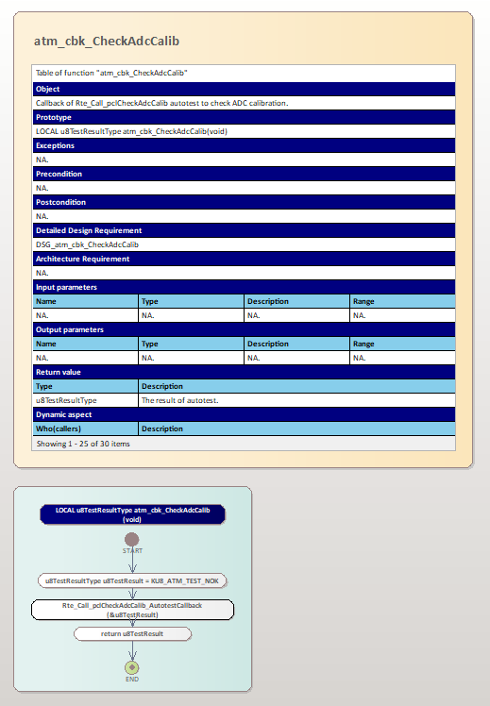
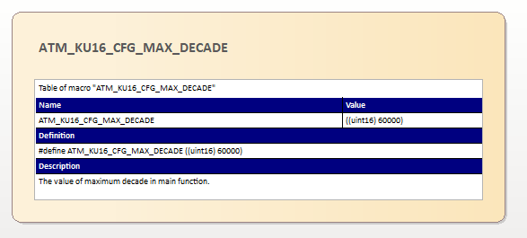
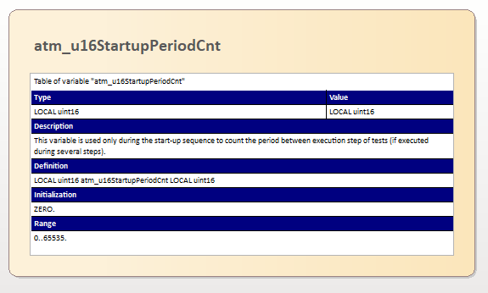
Parsed Data Types
Functions
Defines
Variables

Slide 9
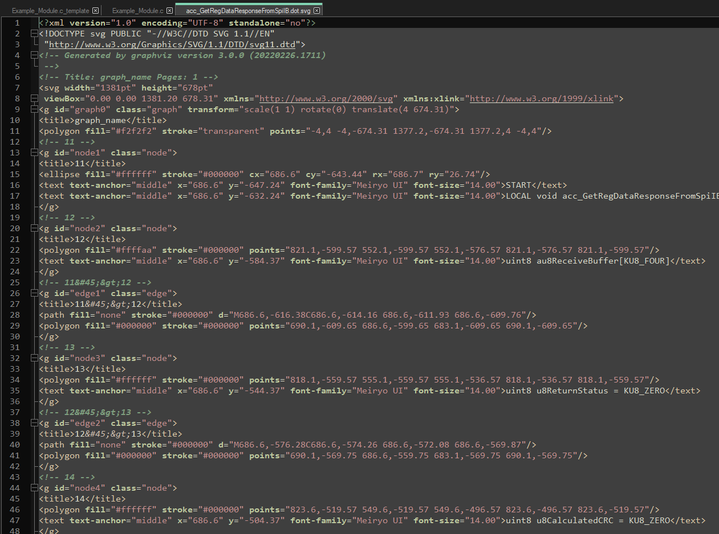
How logic diagrams are generated
The basic tool that parses the code and generates a logic diagram for each function is yFlowGen
It generates a svg graphic file for each function. A svg file is actually an xml file that contains all the elements in the image and their coordinates.
The svg files are parsed and reinterpreted with graphical elements from Enterprise Architect.

Slide 10
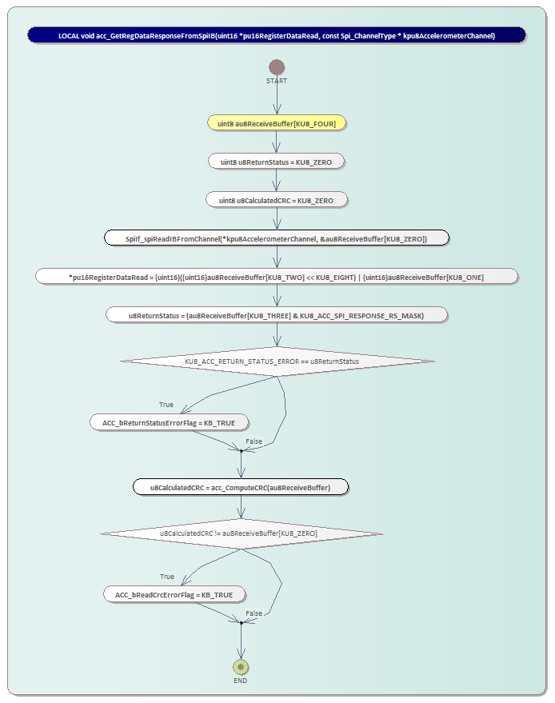
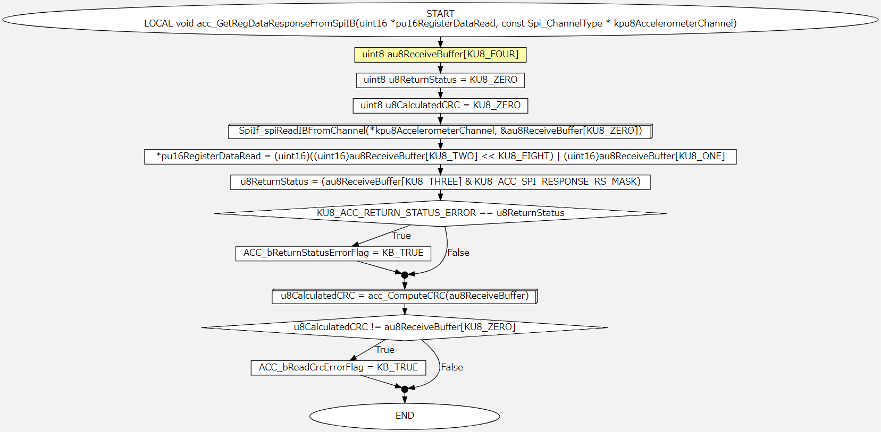
How logic diagrams are generated
Enterprise Architect diagram
Svg diagram

Slide 11
Recommendations
It is absolutely necessary to have Enterprise Architect software installed.
It is necessary for S: Drive to be mapped during runtime of this tool.
Prior to running the script on a certain software component, it is mandatory to verify that all the comments added in code is according to Comments Rules for Enterprise Architect – Detailed Design Generator document. Otherwise, there is a possibility that the Enterprise Architect Model generated does not contain accurate data.
However, after generating the Detailed Design on a given module it is recommended to do a check of the tables and charts, to make sure that the data added is consistent with that in the c_template and h_template files and that the charts look good aesthetically.

Slide 12

Saving More Lives

